Slide 1

Computer Programming for Engineers
Week 3 Lecture 2
Sep. 15, 2022
Lecturer: Mohammad Mahdi Javidan
College of Engineering, Sungkyunkwan University
Fall Semester 2022

Slide 2
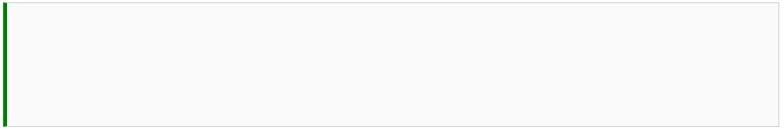

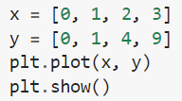
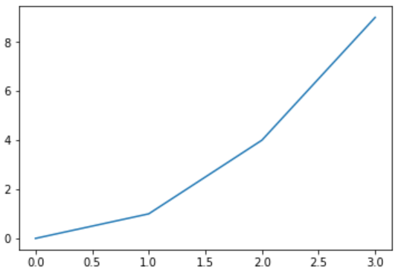
2D Plotting
The most well-known package, matplotlib
https://matplotlib.org/stable/gallery/index.html
The plot function receives list or array
College of Engineering, Sungkyunkwan University

Slide 3


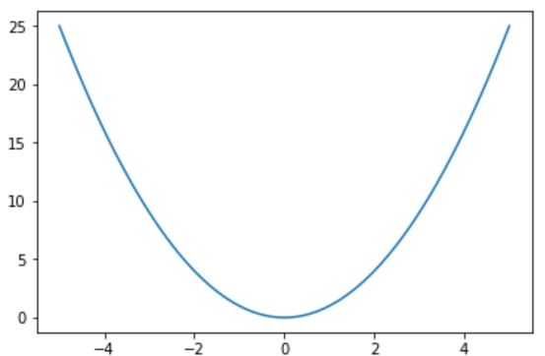
2D Plotting
Stopping the interactive mode, otherwise next plot is drawn in the same figure
Drawing a more smooth graph
College of Engineering, Sungkyunkwan University

Slide 4

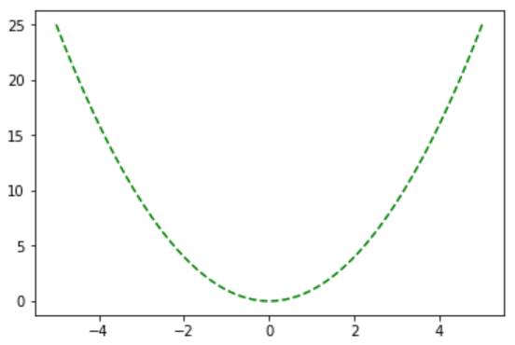
2D Plotting
Modifying the plot
College of Engineering, Sungkyunkwan University

Slide 5

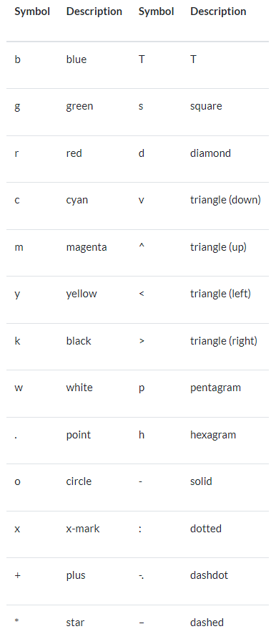
2D Plotting
Parameters for the plot function
--
College of Engineering, Sungkyunkwan University

Slide 6
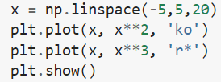
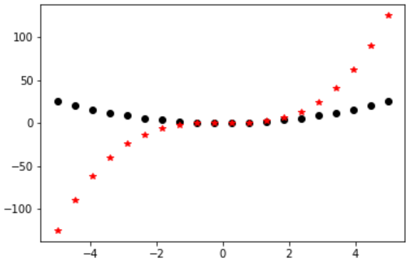
2D Plotting
Another example
College of Engineering, Sungkyunkwan University

Slide 7
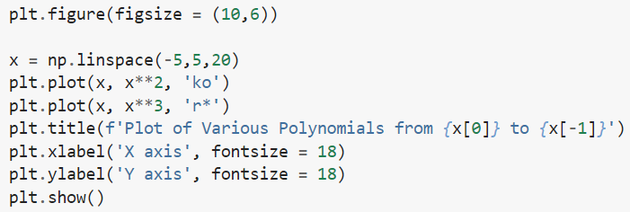
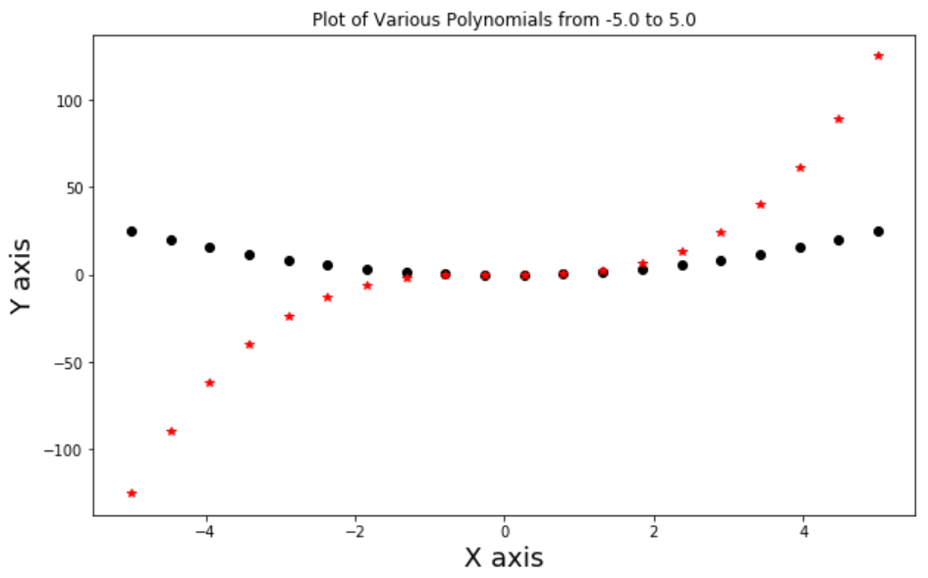
2D Plotting
Another example
College of Engineering, Sungkyunkwan University

Slide 8


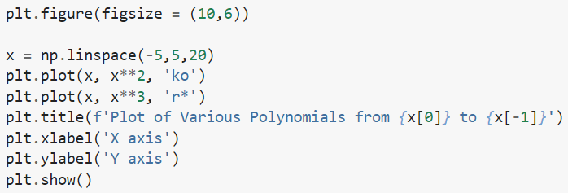
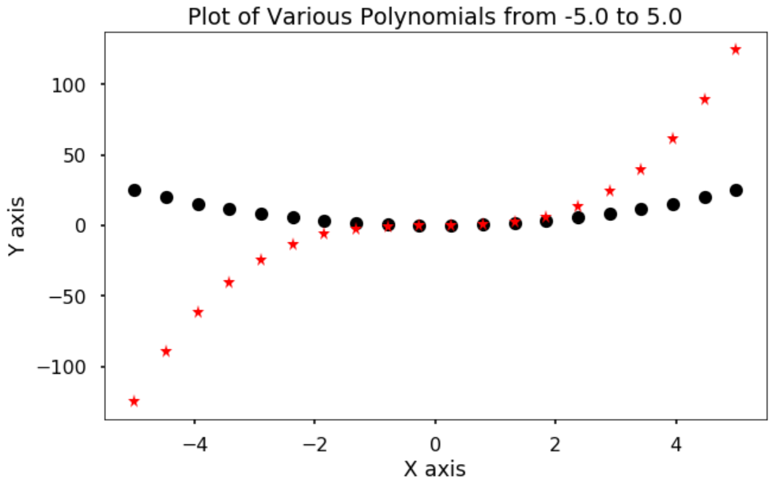
2D Plotting
Using predefined styles
College of Engineering, Sungkyunkwan University

Slide 9
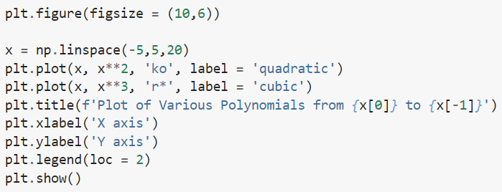
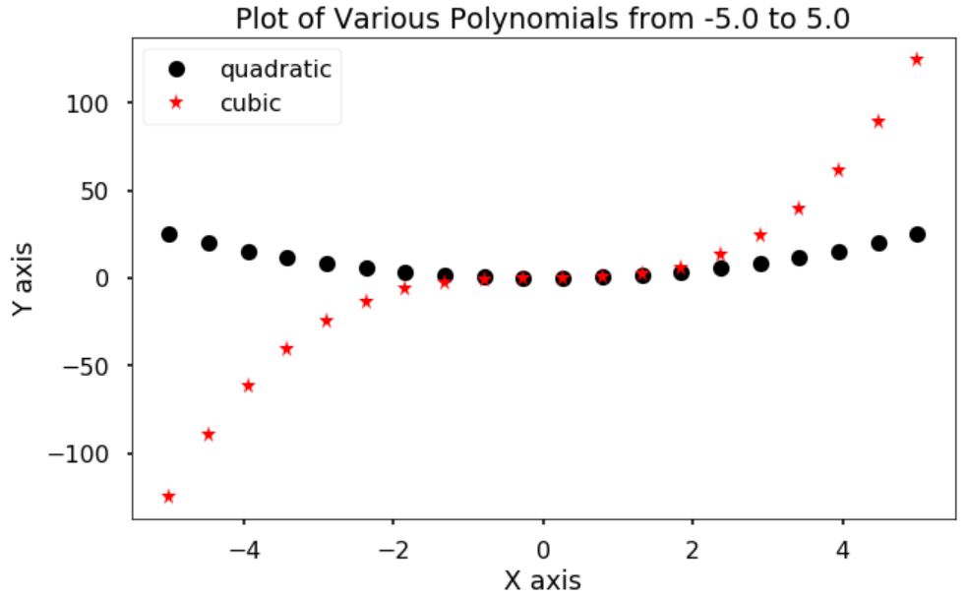
2D Plotting
Showing the legend
Label in the legend
Command for showing the legend
loc can be between 0 to 10
https://matplotlib.org/stable/api/legend_api.html
College of Engineering, Sungkyunkwan University

Slide 10
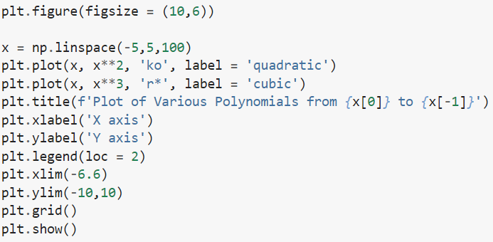
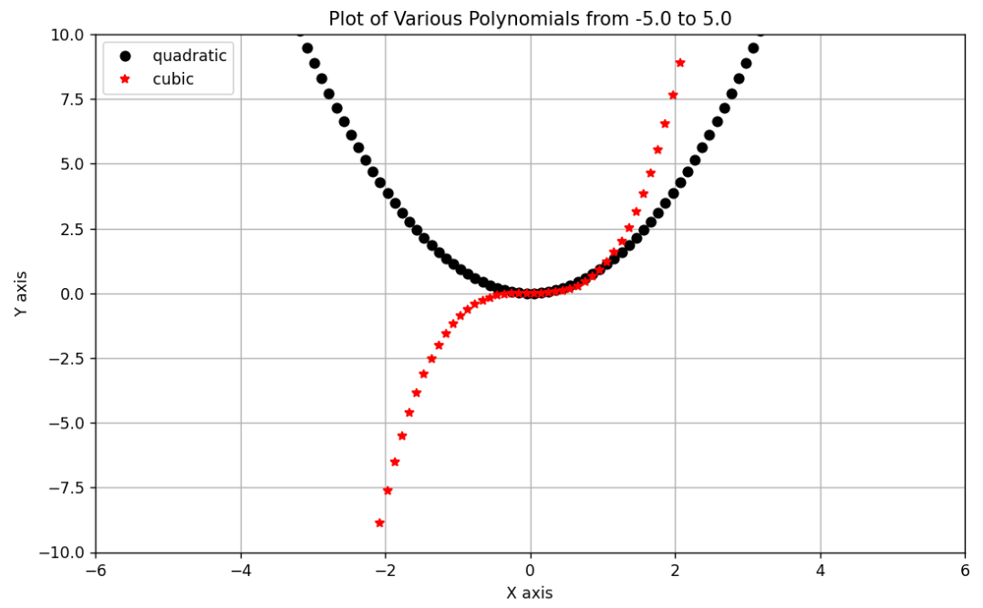
2D Plotting
Showing the legend
loc can be between 0 to 10
,
College of Engineering, Sungkyunkwan University

Slide 11

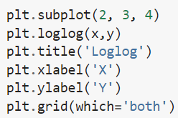
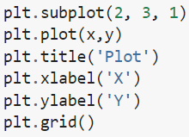
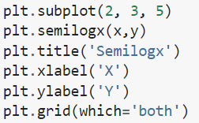
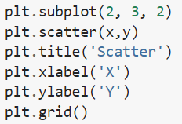
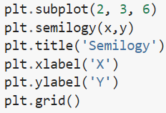
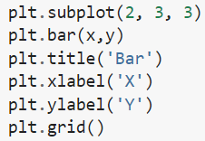

2D Plotting
Subplots and some other types of 2D plots
Grid for major and minor units
Number of subplots in rows and column
Adding grid
Avoiding overlap
College of Engineering, Sungkyunkwan University

Slide 12
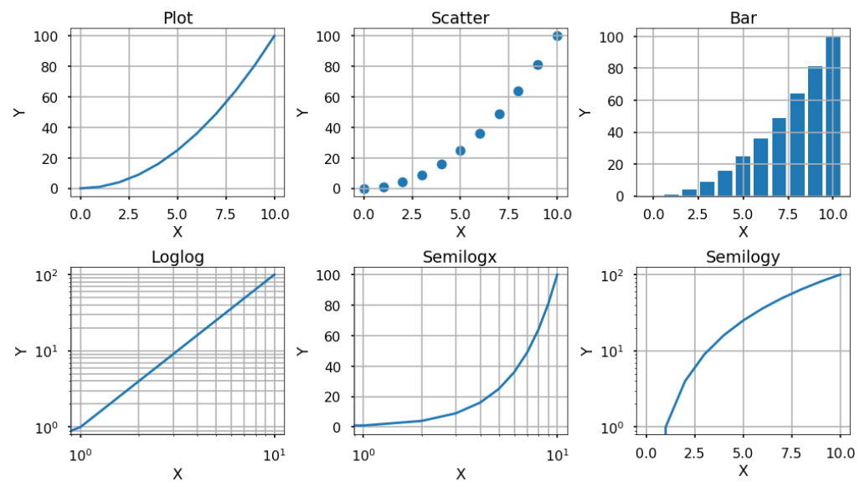
2D Plotting
College of Engineering, Sungkyunkwan University

Slide 13
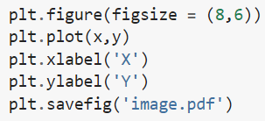
2D Plotting
Saving the plot
Defining the file type
College of Engineering, Sungkyunkwan University

Slide 14
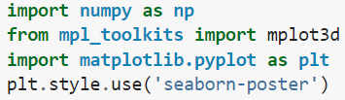

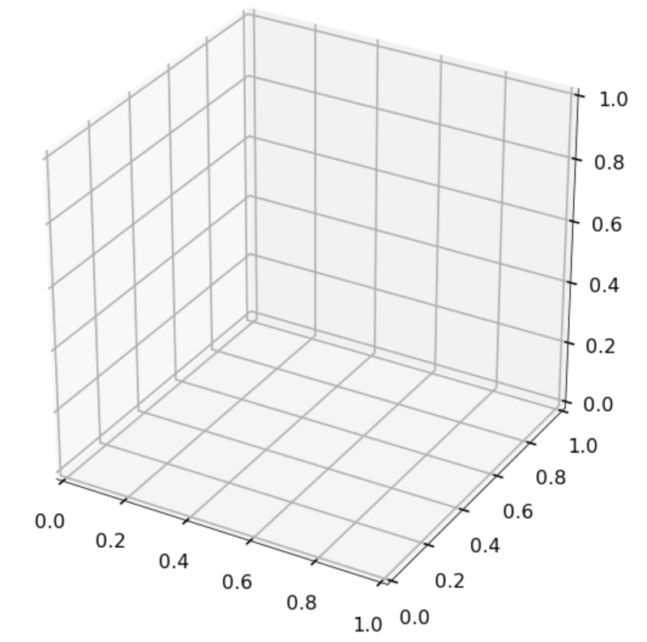
3D Plotting
Adding 3D plotting capabilities to matplotlib
Creating the 3D Axes
College of Engineering, Sungkyunkwan University

Slide 15

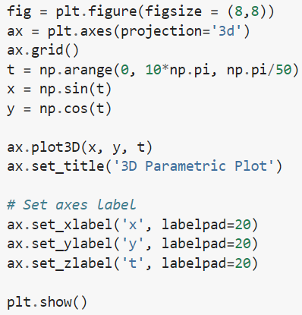
3D Plotting
Data are added to the axes object
Avoiding overlap with the tick text
Setting labels of the axes
College of Engineering, Sungkyunkwan University

Slide 16
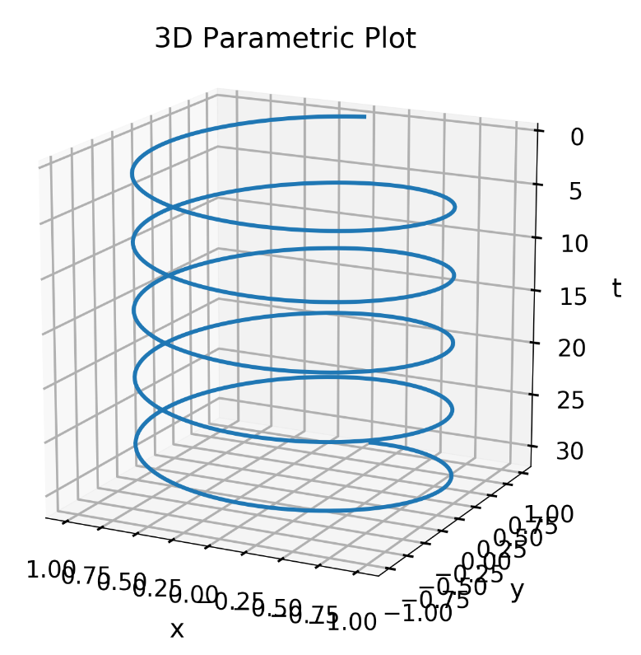
3D Plotting
College of Engineering, Sungkyunkwan University

Slide 17
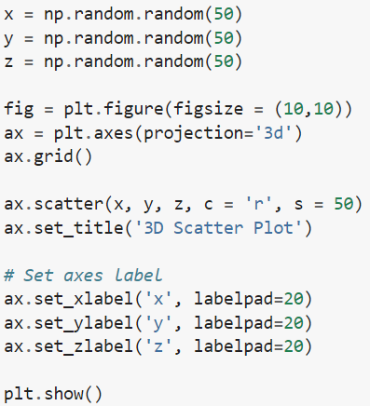
3D Plotting
Scatter plot
Color and size of points
College of Engineering, Sungkyunkwan University

Slide 18
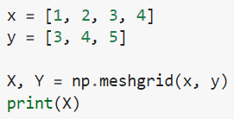


3D Plotting
Defining a mesh
College of Engineering, Sungkyunkwan University

Slide 19
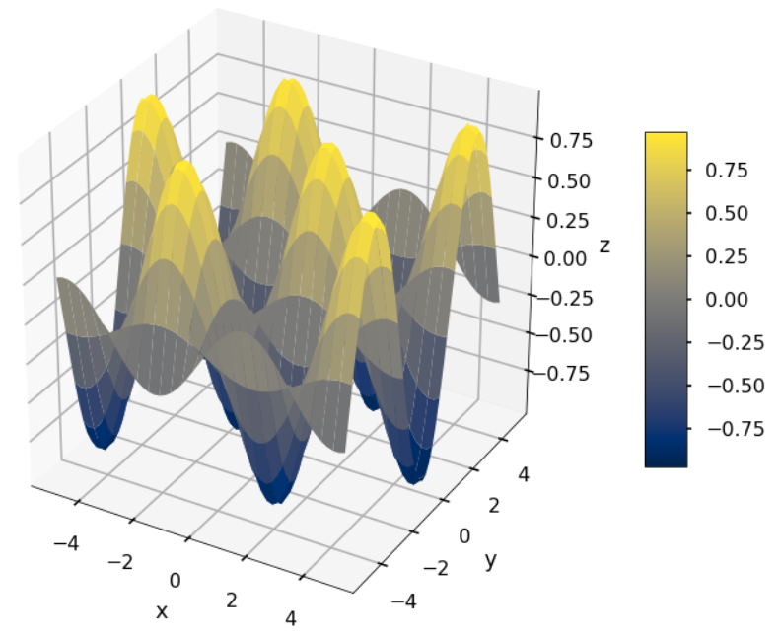
3D Plotting
Drawing 3D Surfaces
College of Engineering, Sungkyunkwan University

Slide 20
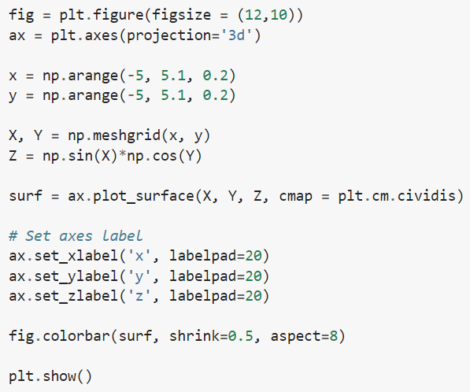
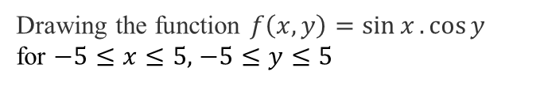
3D Plotting
Drawing 3D Surfaces
Drawing the function $f\left(x,y\right)=\sin{x}.\cos{y}$
for $−5≤x≤5,$ $−5≤y≤5$
Defining contour
Color bar
for contour
College of Engineering, Sungkyunkwan University

Slide 21


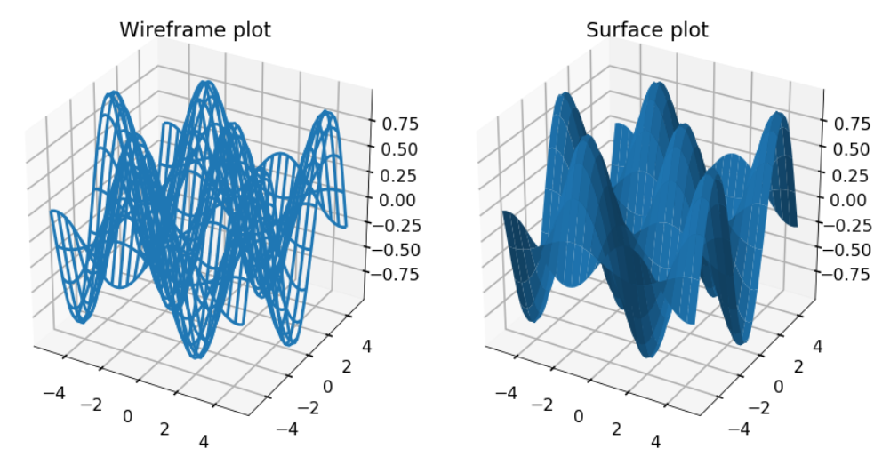
3D Plotting
Subplots in 3D plotting and other styles
College of Engineering, Sungkyunkwan University

Slide 22
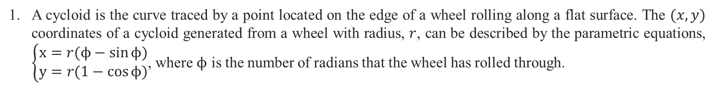
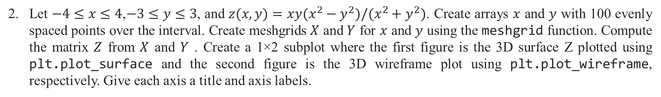
Assignment 4
A cycloid is the curve traced by a point located on the edge of a wheel rolling along a flat surface. The $(x,y)$ coordinates of a cycloid generated from a wheel with radius, $r$, can be described by the parametric equations, $\left\{\begin{matrix}x=r(ϕ−\sin{ϕ}) \\ y=r(1−\cos{ϕ})\end{matrix}\right.$, where $ϕ$ is the number of radians that the wheel has rolled through.
Let $−4≤x≤4$,$−3≤y≤3$, and $z(x,y)=xy(x^{2}−y^{2})/(x^{2}+y^{2})$. Create arrays $x$ and $y$ with 100 evenly spaced points over the interval. Create meshgrids $X$ and $Y$ for $x$ and $y$ using the meshgrid function. Compute the matrix $Z$ from $X$ and $Y$ . Create a 1×2 subplot where the first figure is the 3D surface Z plotted using plt.plot_surface and the second figure is the 3D wireframe plot using plt.plot_wireframe, respectively. Give each axis a title and axis labels.
College of Engineering, Sungkyunkwan University

Slide 23
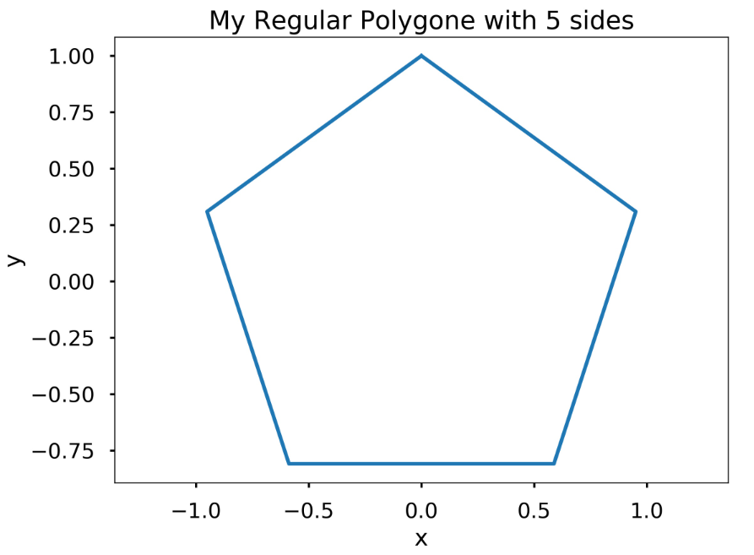
Assignment 4
Write a function my_polygon(n) that plots a regular polygon with n sides and radius 1. Recall that the radius of a regular polygon is the distance from its centroid to the vertices. Use plt.axis(‘equal’) to make the polygon look regular. Remember to give the axes a label and a title. You can use plt.title to title the plot according to the number of sides. Hint: This problem is significantly easier if you think in polar coordinates. Recall that a complete revolution around the unit circle is 2π radians. Note: The first and last point on the polygon should be the point associated with the polar coordinate angles, 0 and 2π, respectively.
Test Case
College of Engineering, Sungkyunkwan University

Slide 24
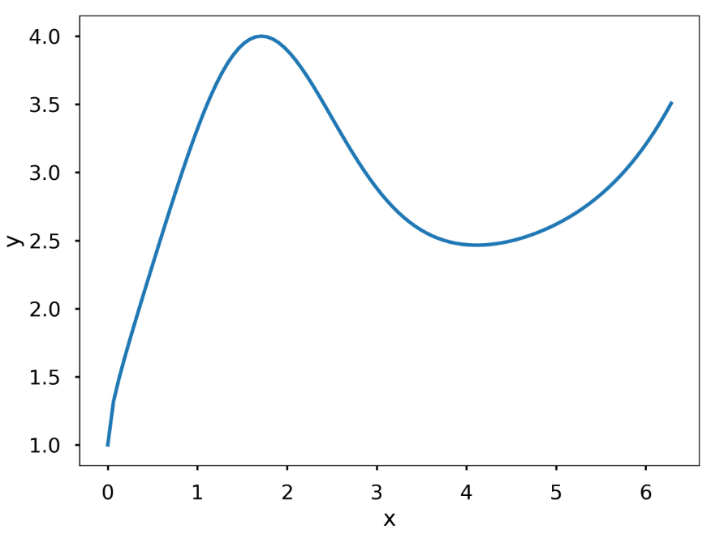
Assignment 4
Write a function my_fun_plotter(f, x) where f is a lambda function and x is an array. The function should plot f evaluated at x. Remember to label the x- and y-axis.
Test Case
College of Engineering, Sungkyunkwan University

